Slide 1
MEETING 11
(STRUCTURE AND WRITTEN EXPRESSION)
PROBLEM WITH PREPOSITION AND USAGE

Slide 2
Objectives:
At the end of this course the students are expected to be able to:
1. Understand the concept of problem with preposition and problem with Usage
2. Identify problems with reposition and with Usage

Slide 3
FIND DEFINITION FROM STRUCTURAL CLUES
Essberger (2016) defines that preposition is a kind of word that appears before a noun within a sentence. It can be also a dependable point indicating the word class of noun will come.

Slide 4
Types of Prepositions
a. Preposition of Time : The prepositions are in, on and at. In refers to the long period of time like month, century, year, or season. Here are some examples:
She began working there in 2010
The first meeting will be held at 1

Slide 5
Types of Prepositions
b. Preposition of Place :The types of prepositions of place are similar to preposition of time. In is used for nonspecific place (name of country, name of city, name of school/university), on is used for more specific place (the name of street), and on is used for the most specific place (Tya’s house). Moreover, other types of prepositions of place are above, under, into, onto, around and others.

Slide 6
Types of Prepositions
c. Preposition of Movement : The types of prepositions are into, onto, across, to, around, up, down, though, past, and others; these kinds refer to the movement of someone or something. Read the following examples:
- I should get into the bus soon unless I will be late
You need to follow me up in order to see him
d. Preposition of Agent : The type of this preposition is by. It is used to relate the doer with the action done by the subject or doer. See the following sentence:
- It is being removed by him

Slide 7
Types of Prepositions
e. Preposition of Instrument
- You are able to paint the wall by this paint brush
Please fill up the form with the help of security

Slide 8
Problems of Preposition
In general, preposition can be used for both literal or idiomatic meanings. Here are the details of incorrect preposition and omitted preposition that you will find on the TOEFL test.
a. Recognize Incorrect Preposition :The kind of error is the mismatch of preposition within a sentence. Actually, the prepositions should be coupled with certain verbs in order to produce readable words or ideas.

Slide 9
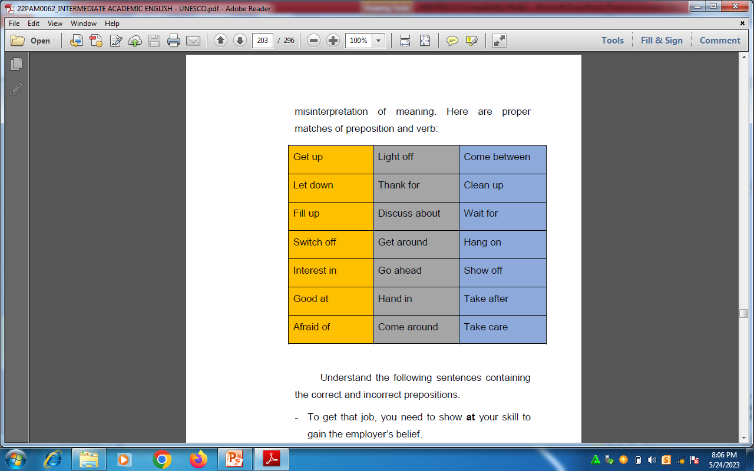
Here are proper matches of preposition and verb:

Slide 10
Problems of Preposition
b. Omitted Preposition :It is obvious that the combination of verb and preposition can deliver the idiomatic expression in a sentence. See some examples of omitting the preposition:
- When you see someone outside, you should let him the room
- I should to thank you for looking when I stayed at your home
Here are the corrections:
When you see someone outside, you should let him in the room
I should to thank you for looking after when I stayed at your home

Slide 11
Problems with Usage
a. Understanding of Usage
Some groups in English group presents similar function and meaning. The most common usage that deliver confusion are make, do, like, alike, unlike, other, another and others. Below, the writers explore the common usage that causes the confusion in both writing and speaking.

Slide 12
Problems with Usage
b. Distinguish Make and Do
Both words: make and do deliver confusion as their meaning seems similar. Do also refers to the action, obligation or the repetitive actions while make refers to result that you do; it seems that you make something, and you will see the results: food, money, relationship, decision, suggestion, notes, communication and many others.

Slide 13
Problems with Usage
b. Distinguish Make and Do
Here are some examples of distinctive sentence with do:
When I get the first salary, I will do some shopping to comfort my self.
Before the semester begins, the lecturers have to do a report to the dean
Here are some examples of distinctive sentences with make:
My roommate lost his one precious glasses; I should make the confession that I did it.
Ge company is awesome since it can make the fantastic profit this year

Slide 14
Problems with Usage
c. Distinguish Like, Alike, and Unlike
Like, alike and unlike also deliver the confusion within a sentence since they seem similar, but they deliver the distinctive functions (Rogers, 2011). Here are some examples of alike and like in several sentences:
- Diana looked like her father when she was a kid
- Diana and her father look alike when she was a kid
- Two boys feel embarrassed because the wear like T-shirt

Slide 15
Problems with Usage
c. Distinguish Like, Alike, and Unlike
The other rule of both like and unlike are they should be followed by noun. See the following examples:
The advanced grammar book in the previous semester is like the book that we learn today.
The advanced grammar book in the previous semester is unlike the book that we learn today

Slide 16
Problems with Usage
d. Distinguish Other, Another, and Others
Other mean alternative, different types, or additional things. Other functions as the determiner, and it can be applied in singular or plural nouns. If other is followed by singular noun, so you need to have another determiner. Here are the examples of other within sentences:
- What kind of other journals have you read before analysing?
- I only see some new students here, where are others?

Slide 17
Problems with Usage
d. Distinguish Other, Another, and Others
Furthermore, another is the combination between an and other. It means an additional thing or an extra thing (singular object). Another has two functions: determiner and pronoun. Here two different sentences showing another as determiner and pronoun:
Will you add another glass of juice for me, please?
The journal will be reviewed by Mr. Kim, and it will be edited by another person.

Slide 18
EXERCISES
1. Read the following sentences and indicate if the sentences are correct or incorrect
Example:
The new students who have registered will queue in the front line, and other should wait in the lobby I (other should be others)
1. The printer has already been repaired for three times this year, so I decided to but another printer.

Slide 19
2. When students do errors in writing their thesis proposal, they should fix them by following lecturers’ suggestions.
3. Like the program in his company, the program in the other company is quite complicated
4. When you drive to Larangan, Tangerang in weekdays, you should access Google map to help you find another routes.
5. Even though the two soft drinks are exactly similar, they are not unlike

Slide 20
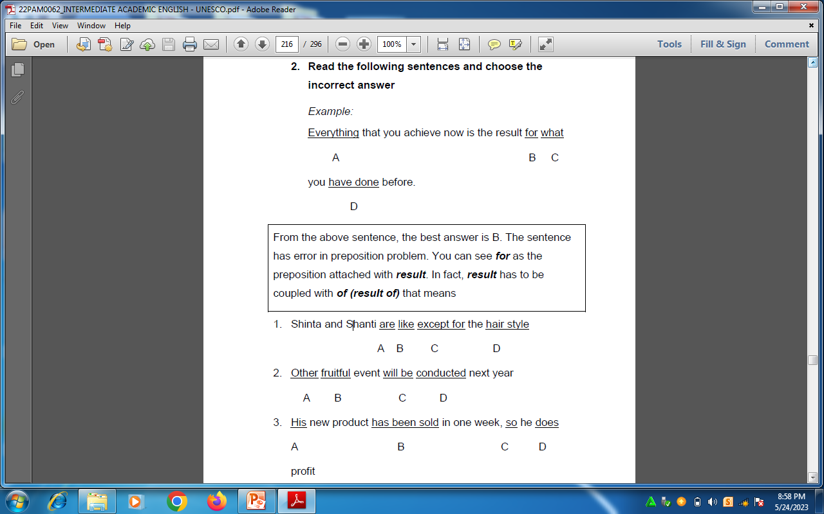

Slide 21
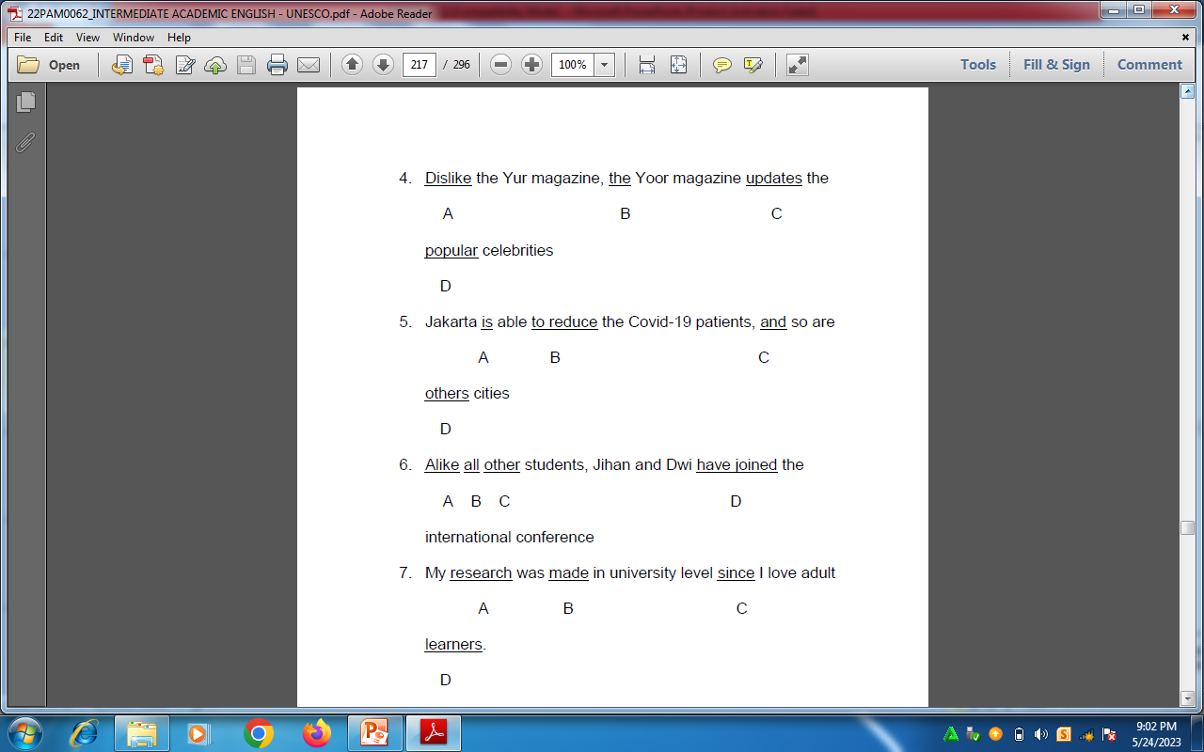

Slide 22
D. REFERENCES
Essberger, J. (2016). English Prepositions List. Cambridge: English club.com
Guswindari, R. (2020, December 12). Penggunaan Do, Does, dan Did dalam Bahasa Inggris. Kompas.com. https://www.kompas.com/skola/read/2020/12/23/192300669/penggunaan-do-does-dan-did-dalam-bahasa-inggris
Phillips, D. (2001). Longman Complete Course for the TOEFL Test. New York: Pearson Education.
Rodgers, B. (2011). The Complete Guide to the TOEFL Test. Massachussetss: Sherrise Roehr

